Slide 1

COVENANT UNIVERSITY
Course Title: Applied Computer Programming II
Course Code: GEC 225
Omega Semester
2020/2021
Lecturers: Prof. E. Adetiba, Mrs Temitope Takpor, Engr. (Mrs) A.H. Ifijeh

Slide 2
1.0 Decision Making in C

Slide 3
Revision of Programming Steps
The following steps are involved when a computer program is used to solve a problem.
i) Analyze the problem
ii) Identify the variables involved
iii) Design the solution
iv) Write the program
v) Enter it into a computer
vi) Compile the program and correct errors
vii) Correct the logical errors if any
viii) Test the program with data
ix) Document the program

Slide 4
Decision Making in C
Decision making is about deciding the order of execution of statements based on certain conditions or repetition of a group of statements until certain specified conditions are met.
C programming language assumes:
any non-zero and non-null values as true,
either zero or null, then is assumed as false value.

Slide 5
Decision Making in C
Decision making structures requires that:
one or more conditions is to be evaluated or tested by the program, while
A statement(s) is/are to be executed if the condition is determined to be true or false.

Slide 6
Decision Making in C
C language handles decision-making by supporting the following statements,
if statement
if...else statement
nested if statements
switch statement
nested switch statements

Slide 7
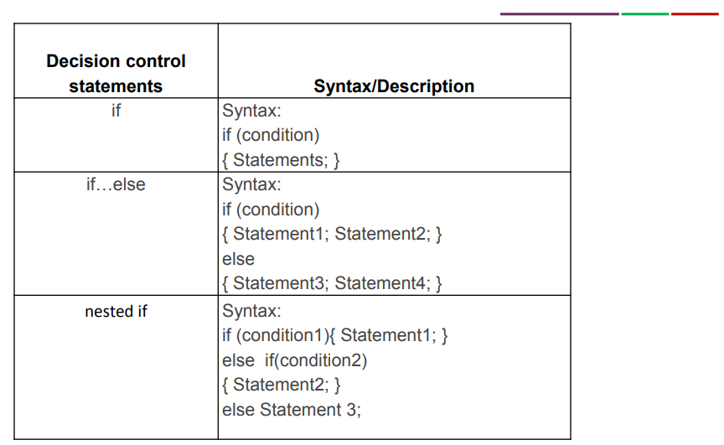
Decision Making in C

Slide 8
1.1 If Statement

Slide 9
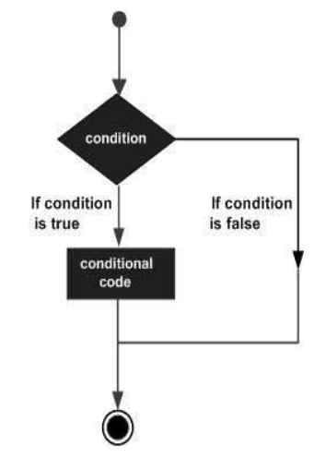
Decision Making in C: If Statement
If the expression is true, then 'statement-inside' will be executed,
Otherwise
'statement-inside' is skipped and only 'statement-outside' is
executed.

Slide 10
Decision Making in C: If Statement
Example Program for If Statement in C:
1#include<stdio.h>
2 int main()
2 {
3 int m=40,n=40;
4 if (m == n)
5 {
6 printf("m and n are equal");
7 }
8 }
OUTPUT: m and n are equal

Slide 11
11
1.2 If…Else Statement

Slide 12
Decision Making in C: If…Else Statement
In if else control statement,
group of statements are executed when condition is true.
However, If condition is false, then else part of the statements are executed.

Slide 13
Decision Making in C: If…Else Statement
The Ternary Operator ? :
Exp1 ? Exp2 : Exp3;
Where: Exp1, Exp2, and Exp3 are expressions.
It can be read as – If Exp1 then Exp2 otherwise Exp3
The outcome of the the expression is determined by:
Exp1 is evaluated. If it is true, then Exp2 becomes the result.
If Exp1 is false, then Exp3 becomes the result.
E.g.
6 == 4? 1:0 // Evaluate 0 since 6 is not equal to 5
Interpret the following?
6>=4?1:0 //

Slide 14
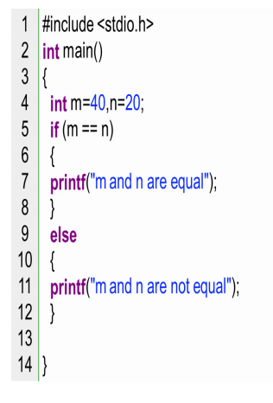
Example Program for If…Else Statement in C:
OUTPUT: m and n are not equal

Slide 15
1.3 Nested If Statement

Slide 16
Decision Making in C: Nested If Statement
In “nested if” control statement:
• if condition 1 is false, then condition 2 is checked and statements are executed if it is true.
• If condition 2 is also false, then
else part is executed.

Slide 17
Example Program for Nested If Statement in C:
#include<stdio.h>
#include<conio.h>
void main()
{
int a;
printf (“enter a number”);
scanf(“%d”,&a);
if(a%5==0 && a%8==0)
{
printf(“divisible by both 5 and 8”);
}
else if(a%8==00 && a%5!=0)
{
printf(“divisible by 8”);
}
else if(a%5==00 && a%8!=0)
{
printf(“divisible by 5”);
}
else
{
printf(“divisible by none”);
}
getch();
}

Slide 18
Class Exercise 1

Slide 19
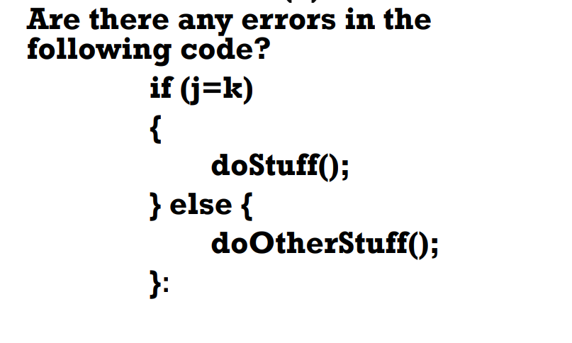
Questions
(a)

Slide 20

Questions
(b)
Write a simple C program to calculate the area of a circle using

Slide 21
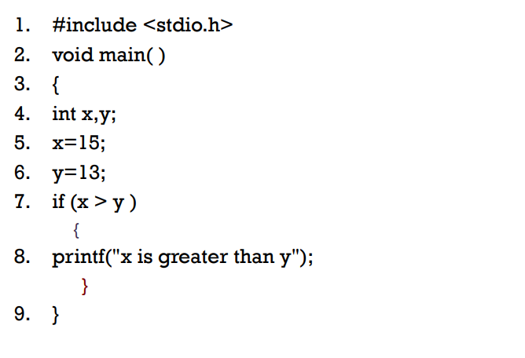
Questions
(c)
What is the output of this program?

Slide 22
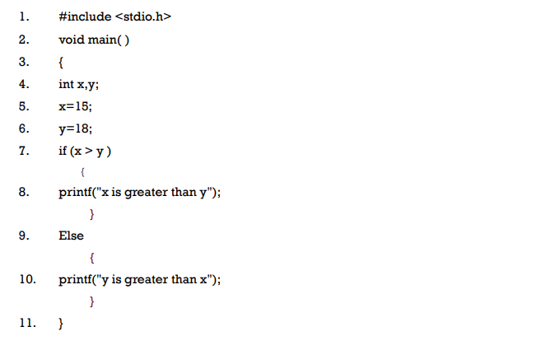
Questions
(d)
What is the output of this program?

Slide 23
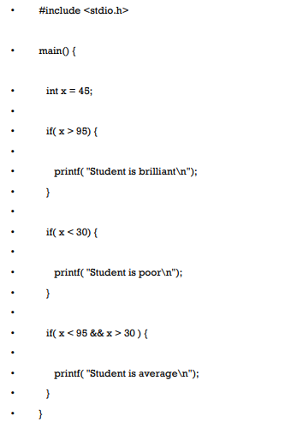
Questions
(e)
What is the output of this program?

Slide 24
Assignment 1
Write C program for the following tasks:
1) Check Whether an Integer is Prime or Not
2) Check Whether a Number is Even or Odd
3) Check Whether a Character is Vowel or consonant
4) Check Whether the Entered Year is Leap Year or
Not
5) Check Whether a Number is Positive or Negative
or Zero.
Note: Assignment 1 (codes and outputs) are to be submitted latest by…, 2021 on the Moodle Platform.

Slide 25
1.4 Case Control Statement

Slide 26
C – Case Control Statements
The statements which are used to execute only specific block of statements in a series of blocks are called case control statements.
There are 4 types of case control statements in C
language.
i) switch
ii) break
iii) continue
iv) goto

Slide 27
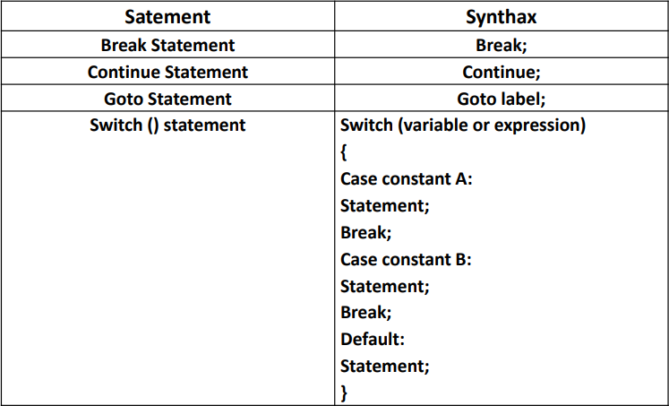
C – Case Control Statements

Slide 28
1.4.1 Switch Case Statement in C:
Switch case statements are used to execute only specific case
statements based on the switch expression.
Syntax for switch case statement.
switch (expression)
{
case label1: statements;
break;
case label2: statements;
break;
case label3: statements;
break;
default: statements;
break;
}

Slide 29
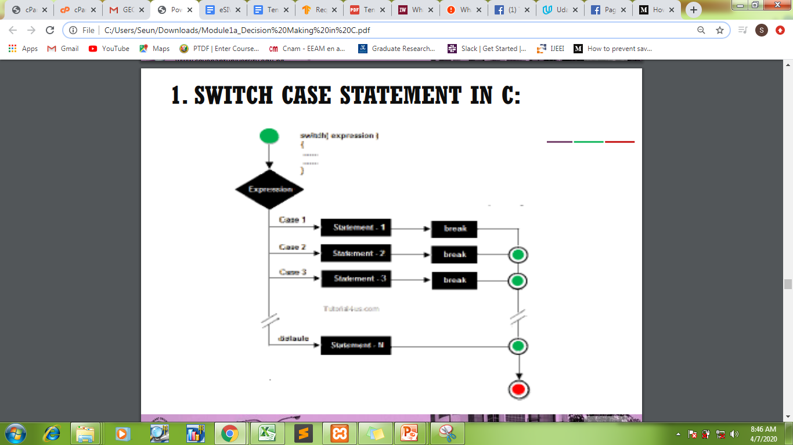
Switch Case Statement in C:

Slide 30
Switch Case Statement in C:
Rules for applying switch
With switch statement use only byte, short, int, char data types.
You can use any number of case statements within a switch.
Value for a case must be same as the variable in switch.
Limitations of switch
Relational operators cannot be used with switch statement. For
instance
case k>=20: //is not allowed
Switch case variables can have only int and char data types, so float data type is not allowed.

Slide 31
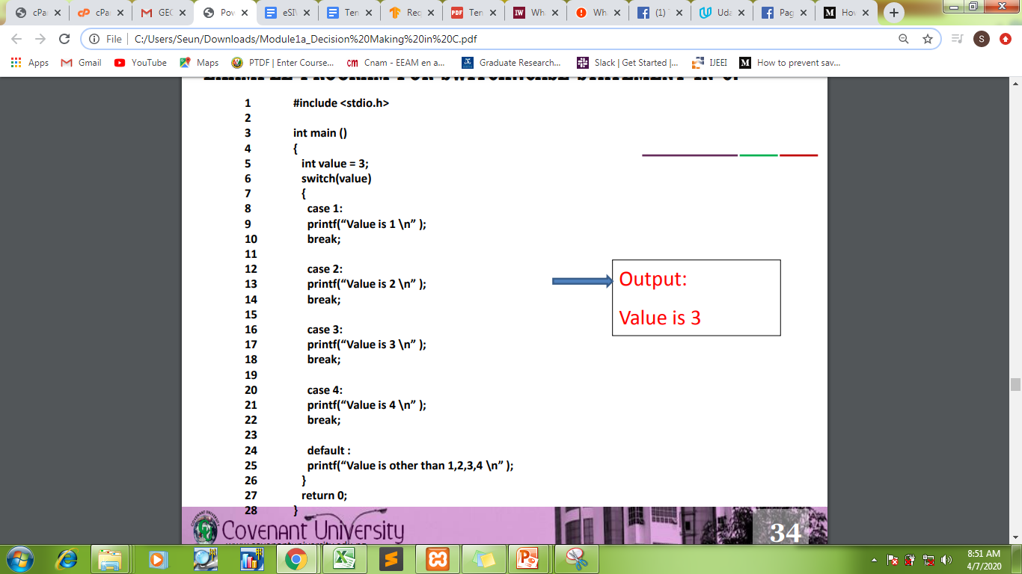
Example Program for Switch…Case Statement in C:

Slide 32
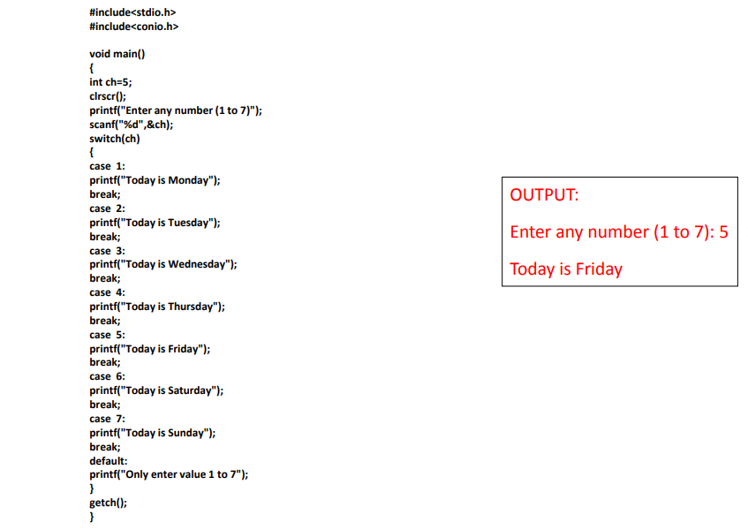
Example Program for Switch…Case Statement in C:

Slide 33
Switch…Case Statement in C:
Assignment 2
• Develop a Simple Calculator to Add, Subtract, Multiply or Divide any given number using switch...case.
Note: Assignment 2 (codes and output) are to be submitted latest by …, 2021 on the Moodle Platform.

Slide 34
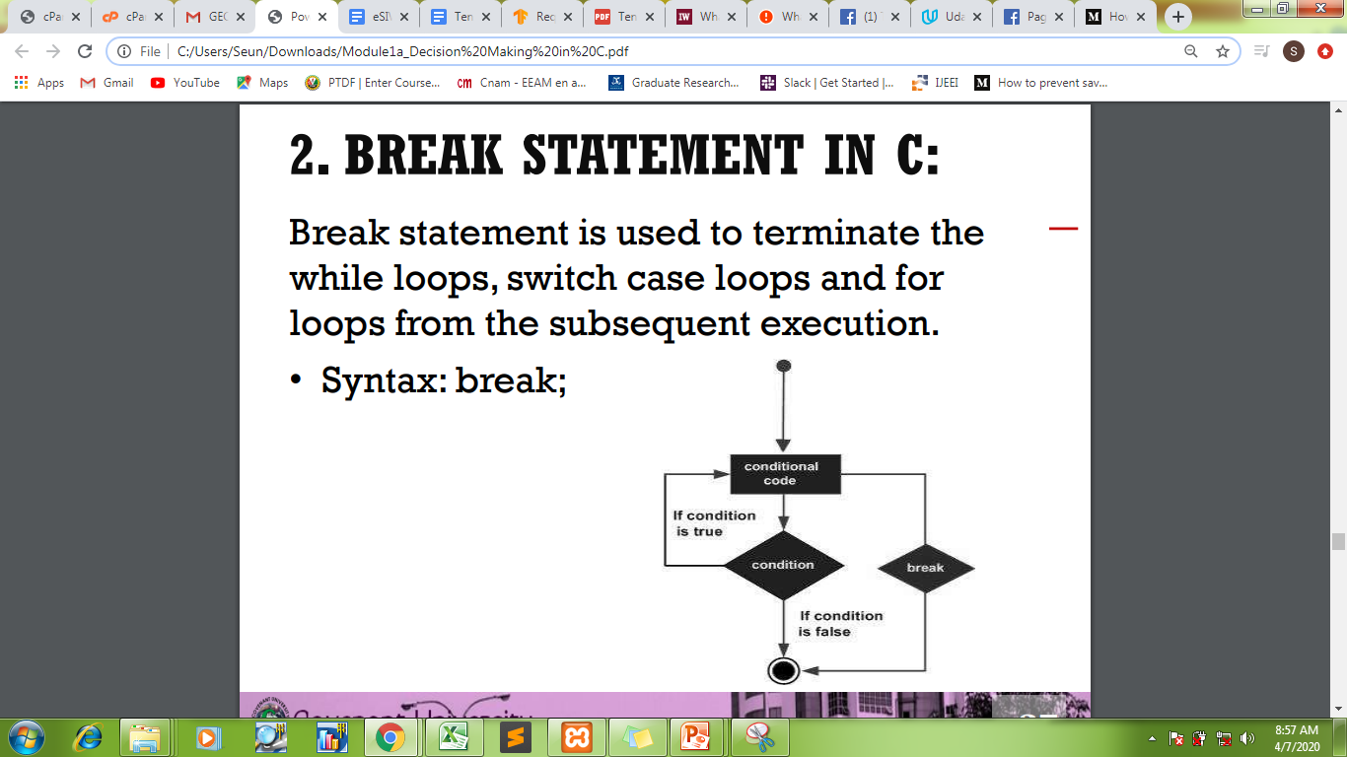
1.4.2. Break Statement in C
Break statement is used to terminate the while loops, switch case and for loops from the subsequent execution.
• Syntax: break;

Slide 35
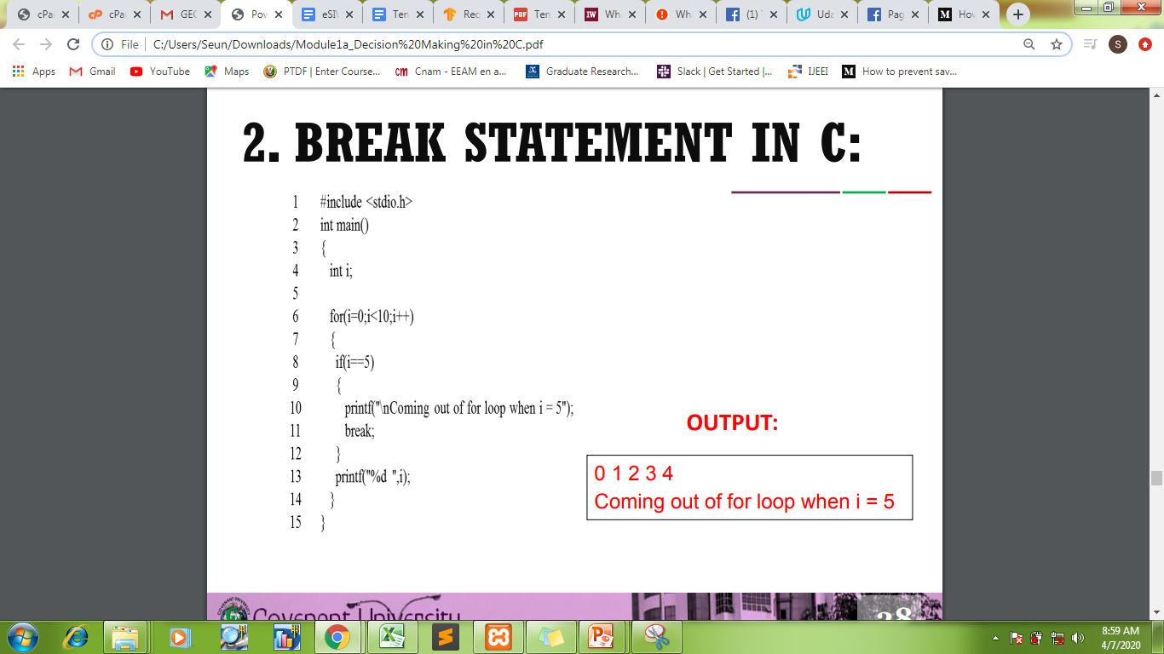
Break Statement in C:

Slide 36
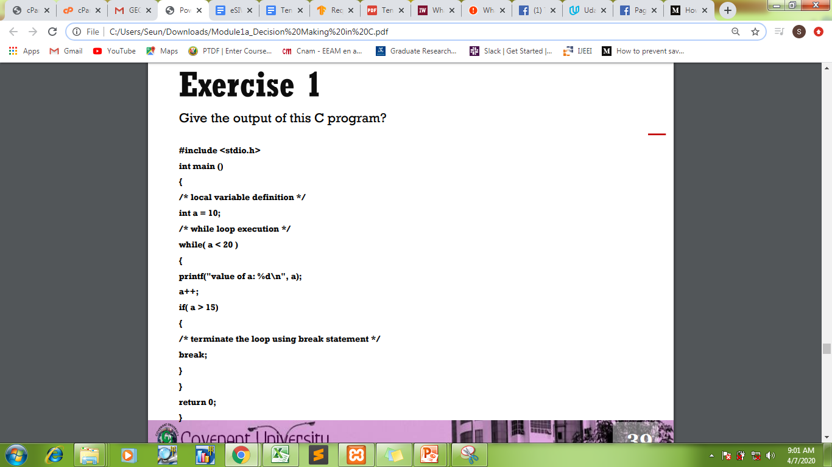
Break Statement in C:
Class Exercise 2
Give the output of this C program

Slide 37
Break Statement in C:
Result of Exercise 2
value of a: 10
value of a: 11
value of a: 12
value of a: 13
value of a: 14
value of a: 15

Slide 38
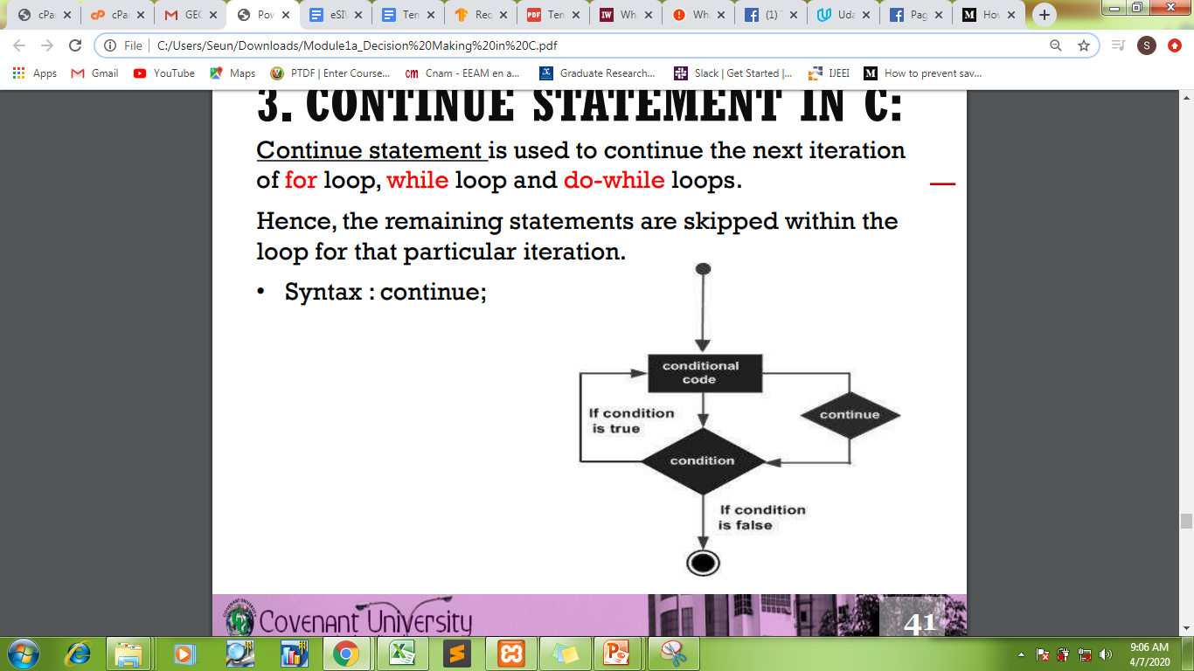
1.4.3. Continue Statement in C
Continue statement is used to continue the next iteration of for loop, while loop and do-while loops.
Hence, the remaining statements are skipped within the loop for that particular iteration.
• Syntax : continue;

Slide 39
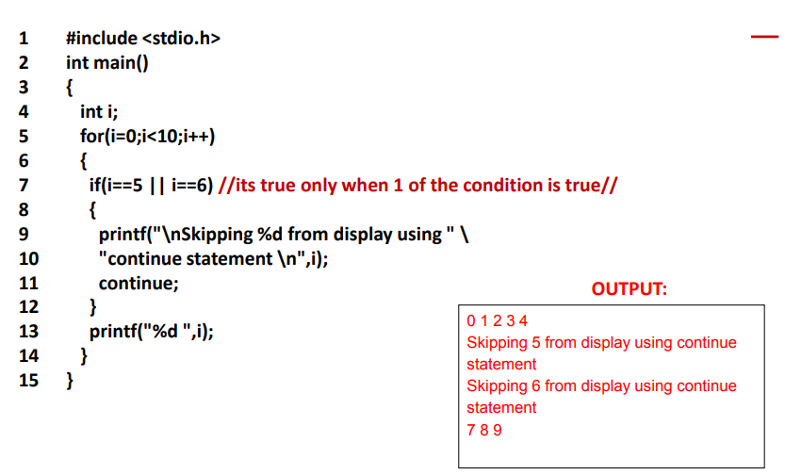
Continue Statement in C: EXAMPLE

Slide 40
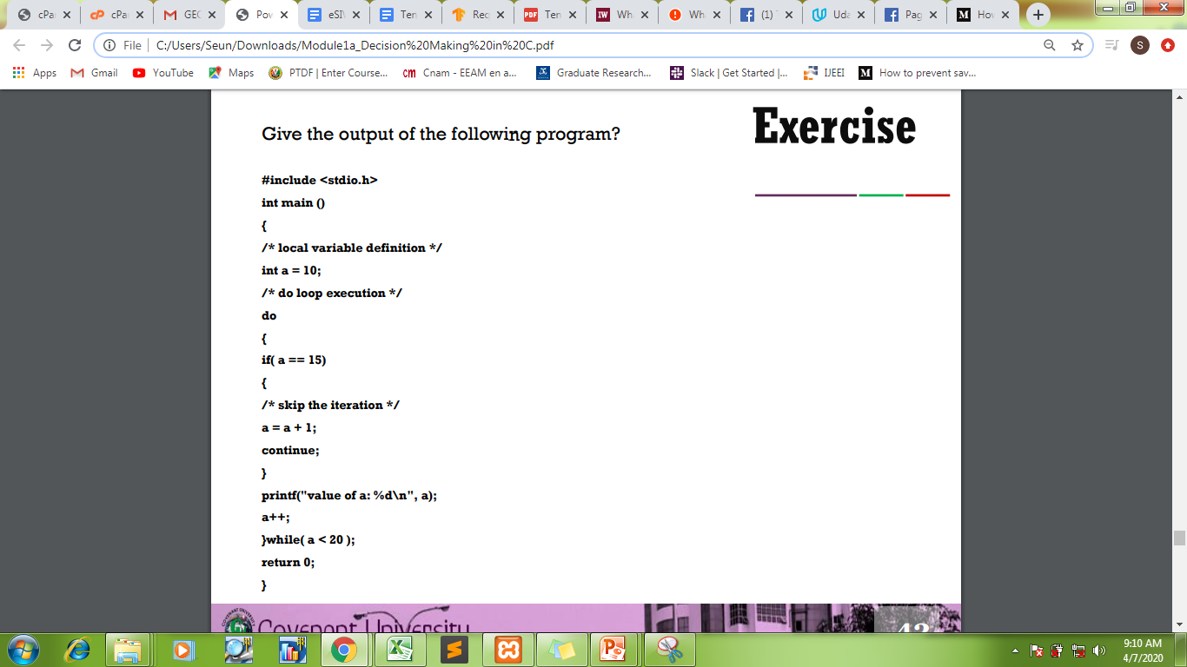
Continue Statement in C:
Class Exercise 3
Give the output of the following program

Slide 41
Continue Statement in C:
Output Values for Exercise 3
value of a: 10
value of a: 11
value of a: 12
value of a: 13
value of a: 14
value of a: 16
value of a: 17
value of a: 18
value of a: 19

Slide 42
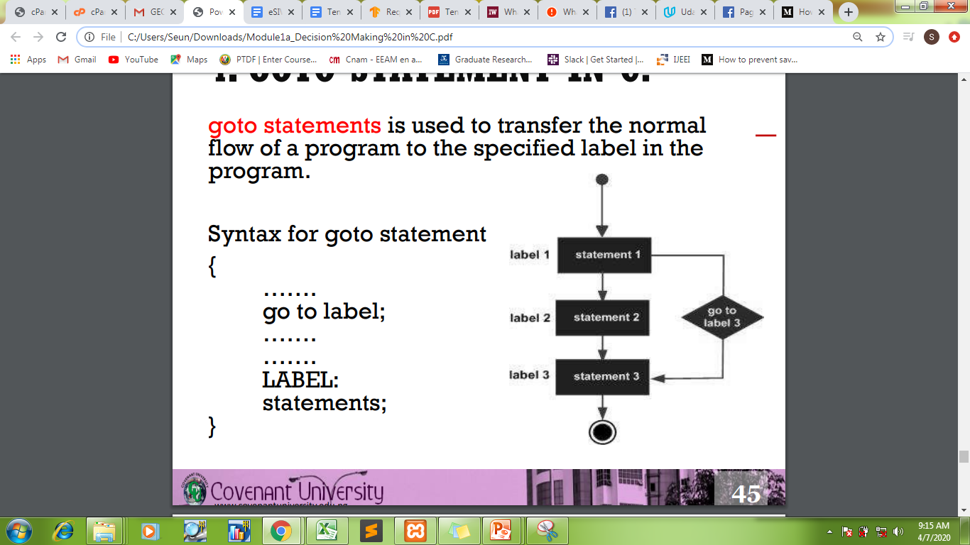
1.4.4. GOTO Statement in C
goto statements is used to transfer the normal flow of a program to the specified label in the program.
Syntax for goto statement
{
…….
go to label;
…….
…….
LABEL:
statements;
}

Slide 43
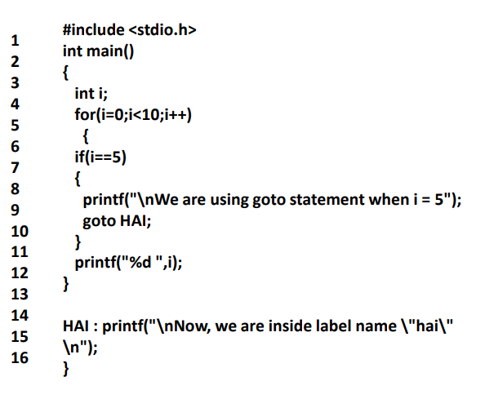
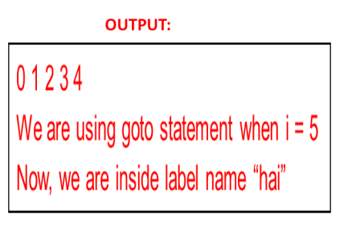
4. GOTO Statement in C: EXAMPLE

Slide 44
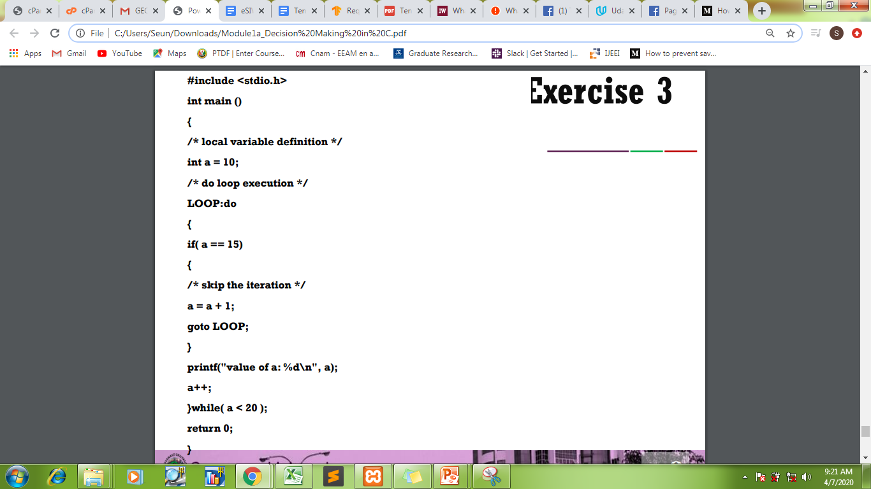
4. GOTO Statement in C:
Class Exercise 4
Give the output of the following program
Output Value for Exercise 3
value of a: 10
value of a: 11
value of a: 12
value of a: 13
value of a: 14
value of a: 15
value of a: 16
value of a: 17
value of a: 18
value of a: 19

Slide 45
Thank You All for Listening

